Slide 1




Week-5 (Discussion)
25th Feb, 2025
Deep Learning
Prof. Sudarshan Iyenger
Professor and Head of the Department
Department of Computer Science and Engineering
IIT Ropar
Ayan Paul
PMRF Research Scholar
IIT Kharagpur

Slide 2
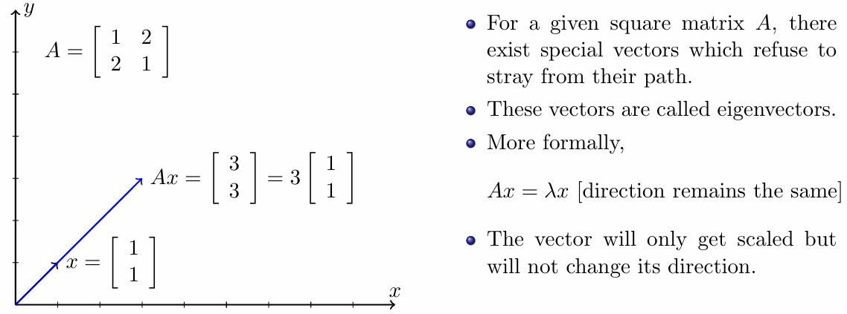
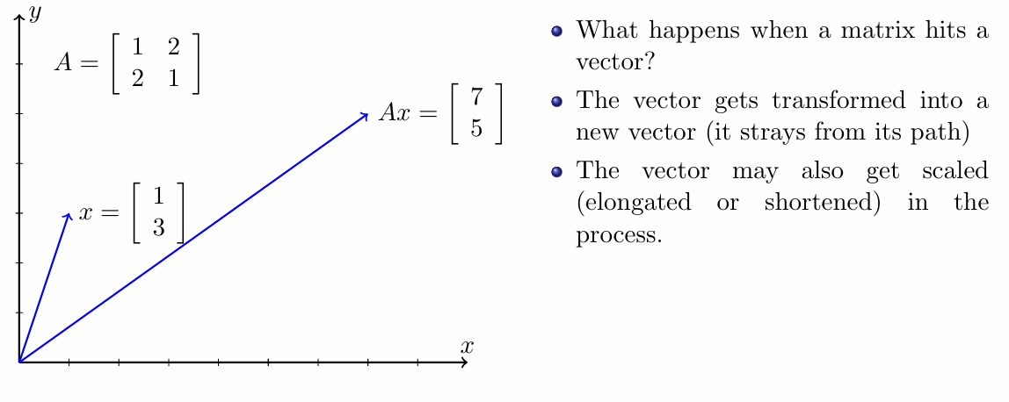
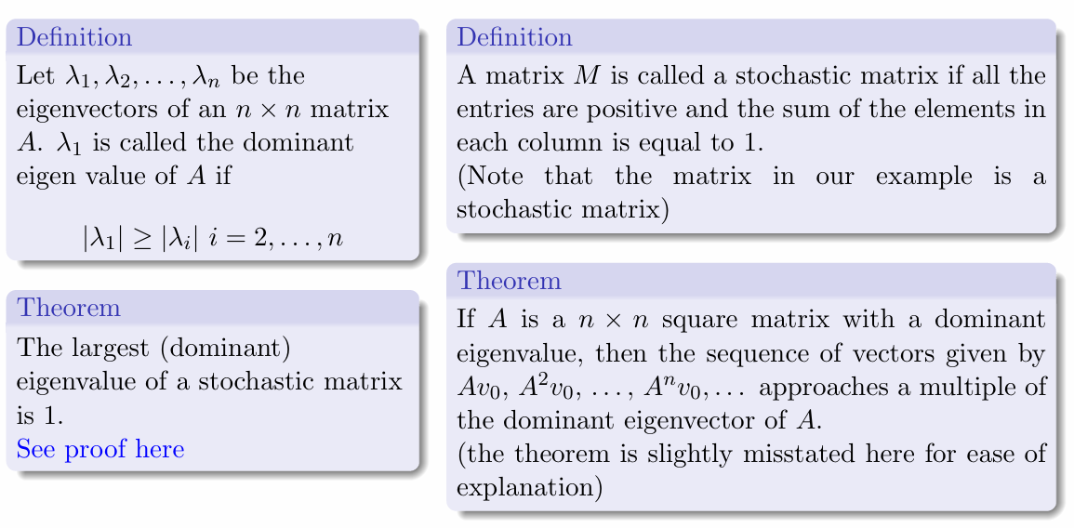
Eigenvalues and Eigenvectors
Eigenvectors are the directions that remain unchanged during a transformation, even if they get longer or shorter. Eigenvalues are the numbers that indicate how much something stretches or shrinks during that transformation.
The word ‘Eigen’ is of German Origin which means ‘characteristic’.
How to Find Eigenvalues and Eigenvectors
(A-λI)x = 0
Solving the above equation we get various values of λ as λ₁, λ₂, …, λ_{n} these values are called the eigenvalues and we get individual eigenvectors related to each eigenvalue.
Some Definitions and Theorems related to the concept

Slide 3
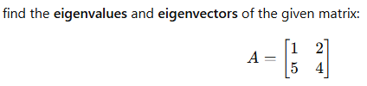
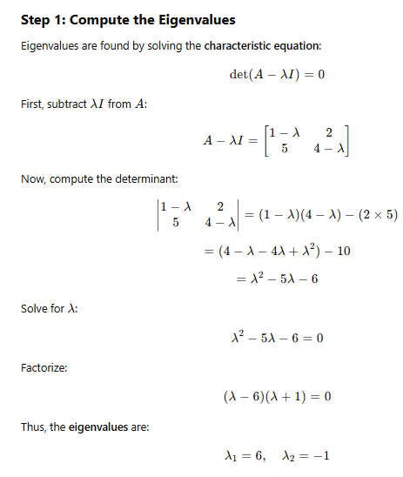
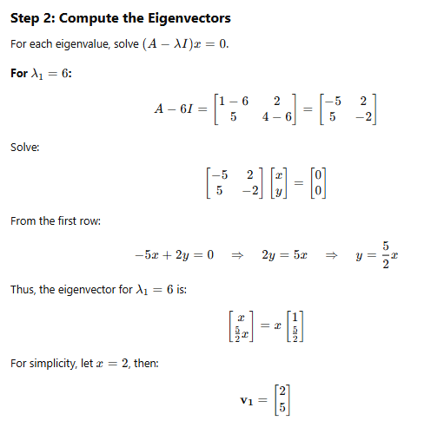
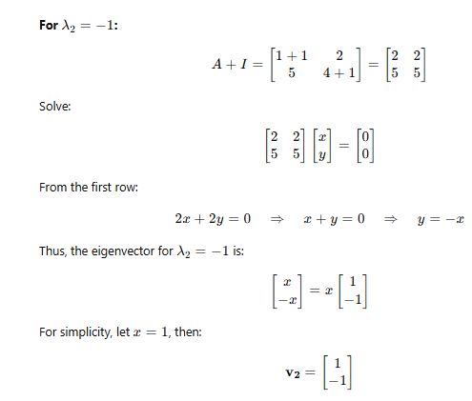
Sample Question

Slide 4
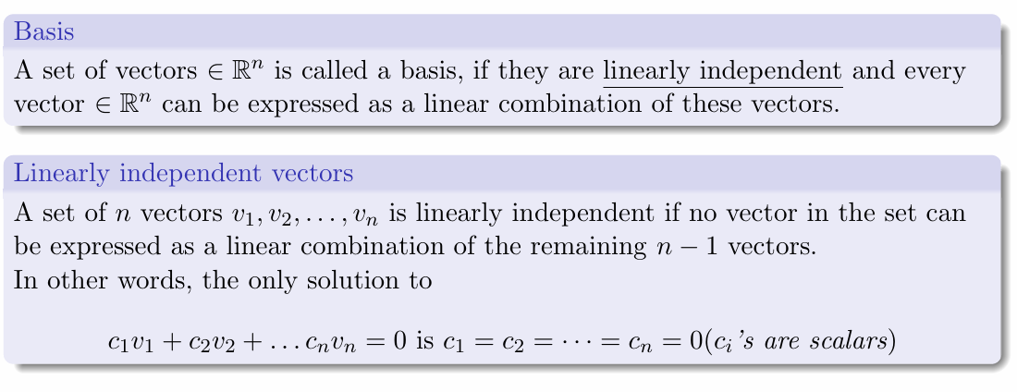
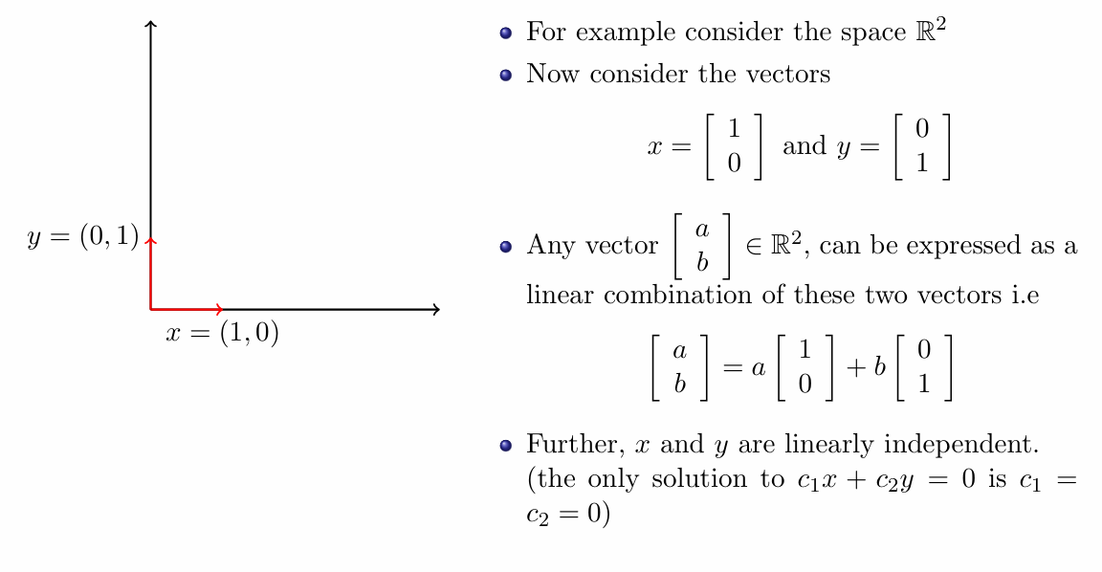
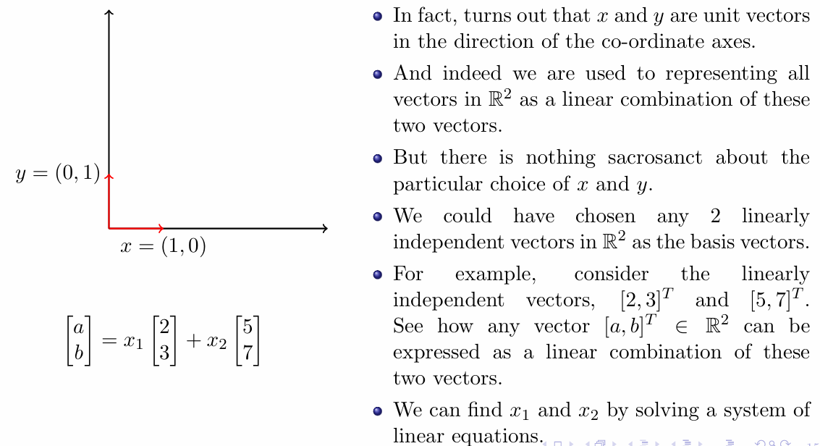
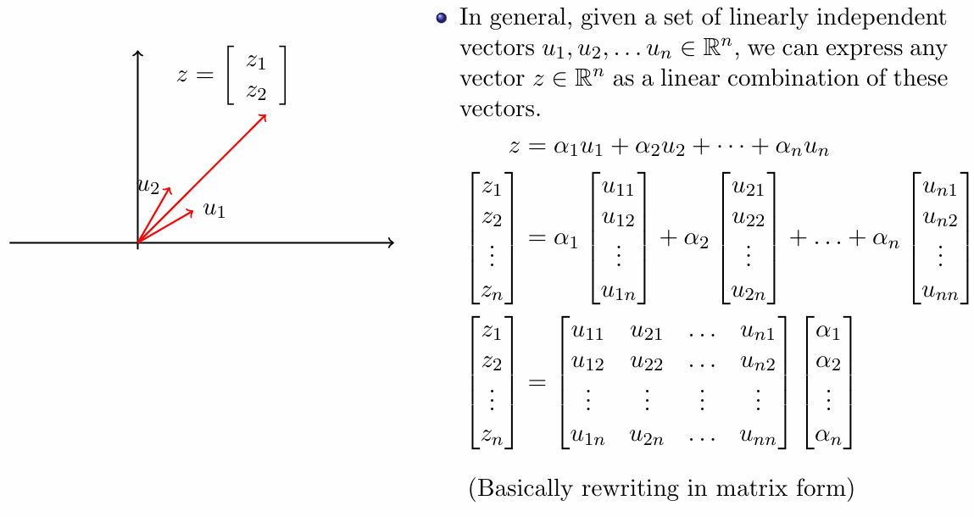
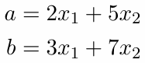

Linear Algebra

Slide 5
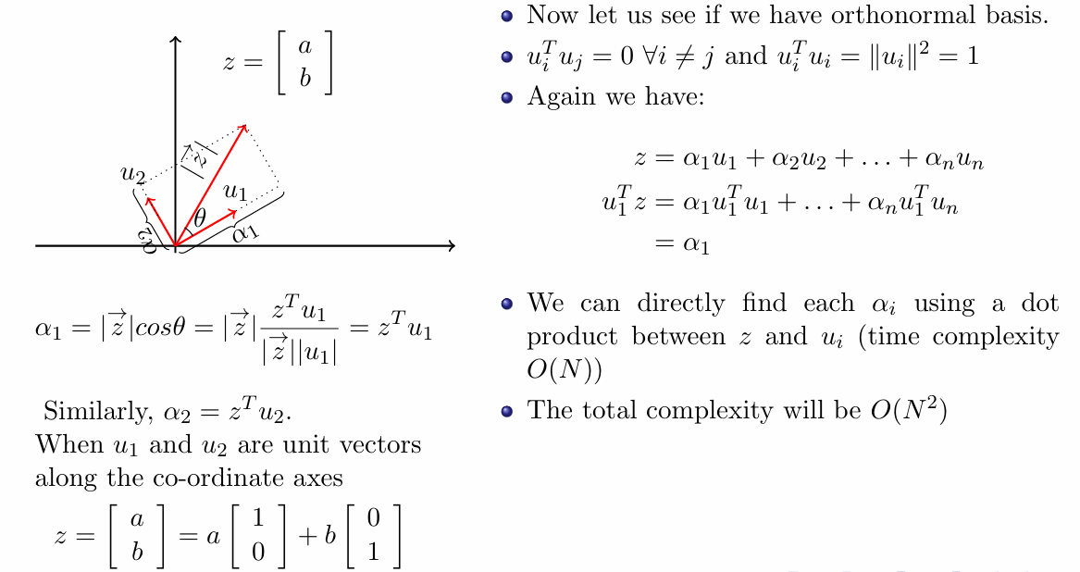
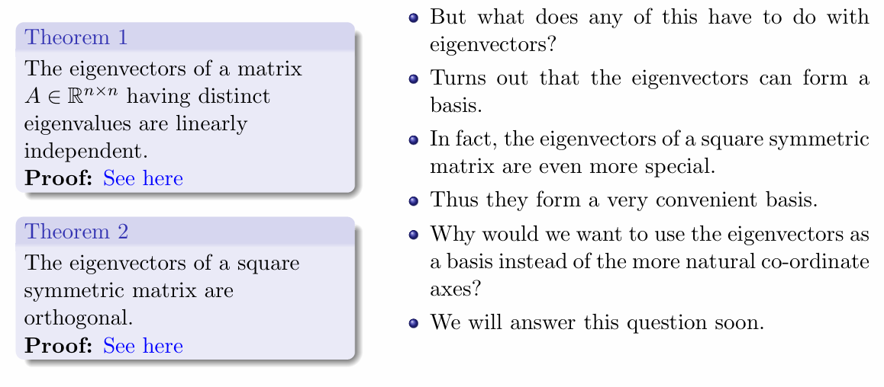
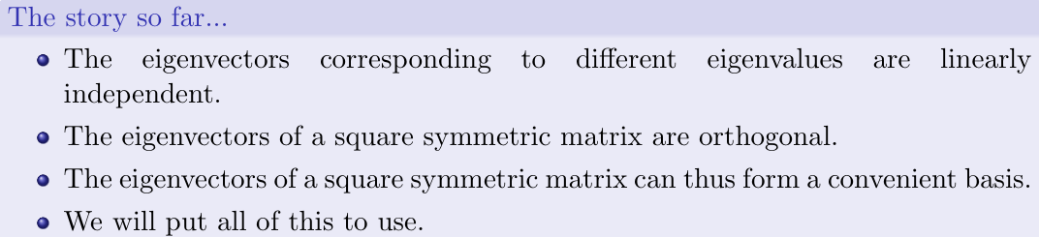
Advantage of Orthonormal vector forming a basis

Slide 6
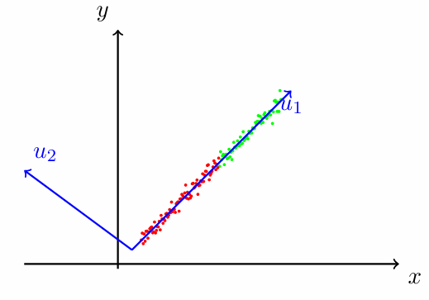
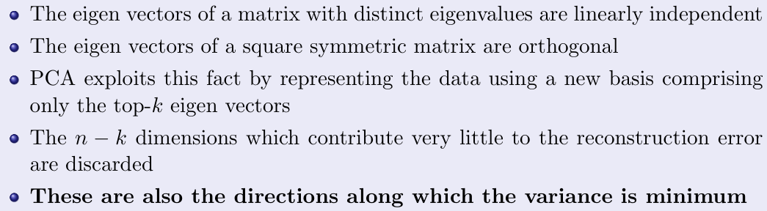
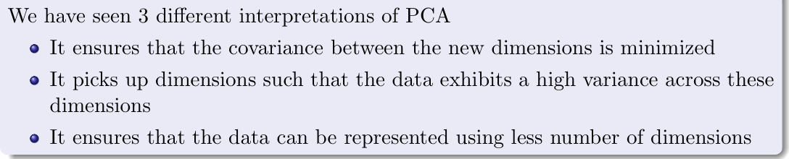
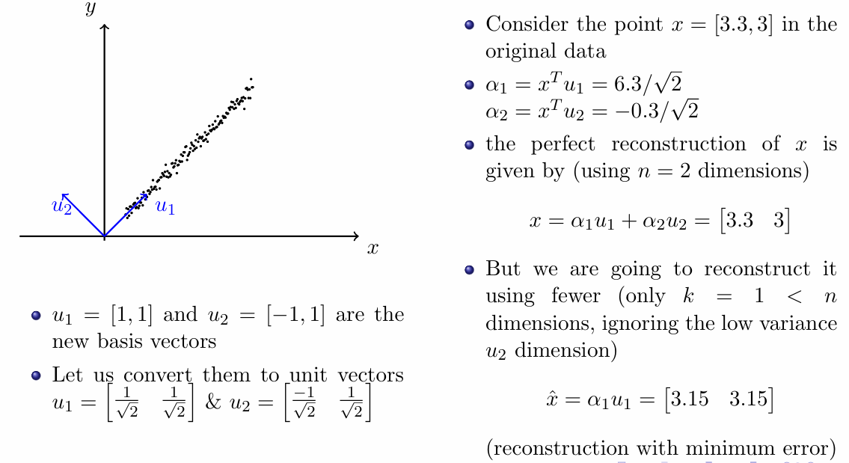
Principal Component Analysis
Example of the Reconstruction Error

Slide 7


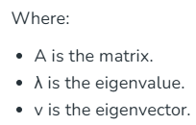
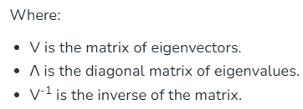
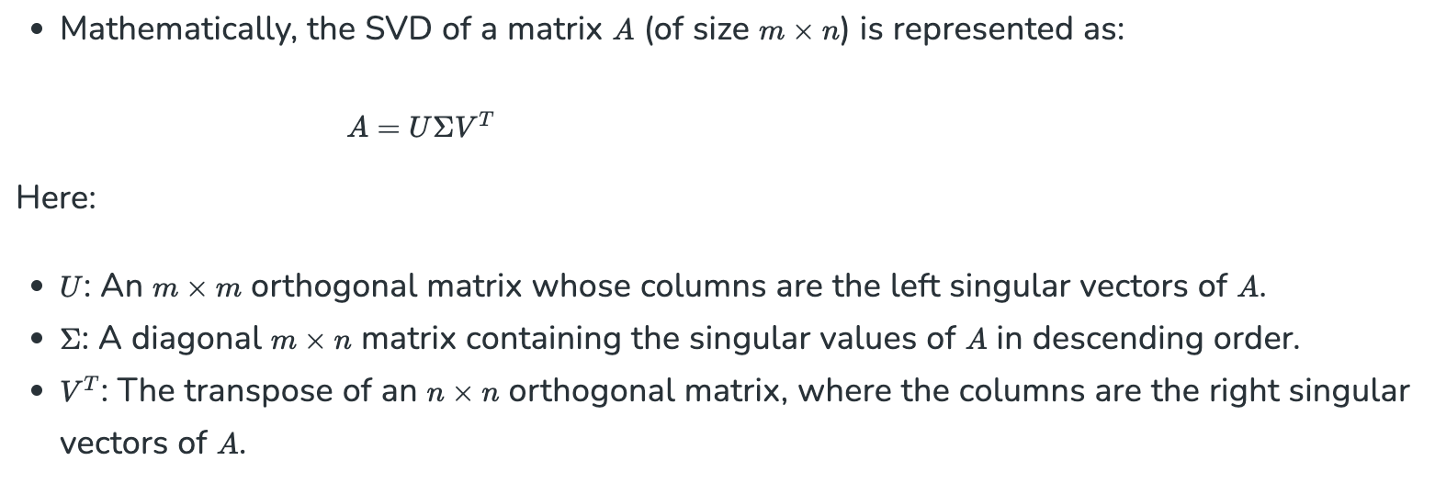
Eigen Value Decomposition
Eigen decomposition is a method used in linear algebra to break down a square matrix into simpler components called eigenvalues and eigenvectors.
This decomposition is significant because it transforms matrix operations into simpler, scalar operations involving eigenvalues, making computations easier.
Singular Value Decomposition
It generalizes the Eigen value decomposition of a square matrix with an orthonormal eigen basis to any ⁠m × n matrix.

Slide 8
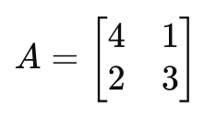
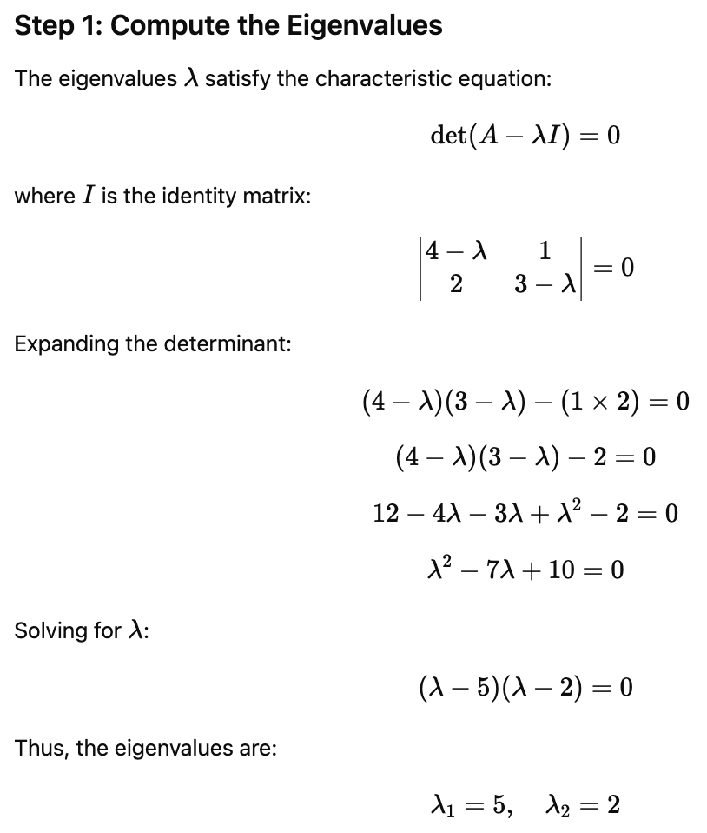
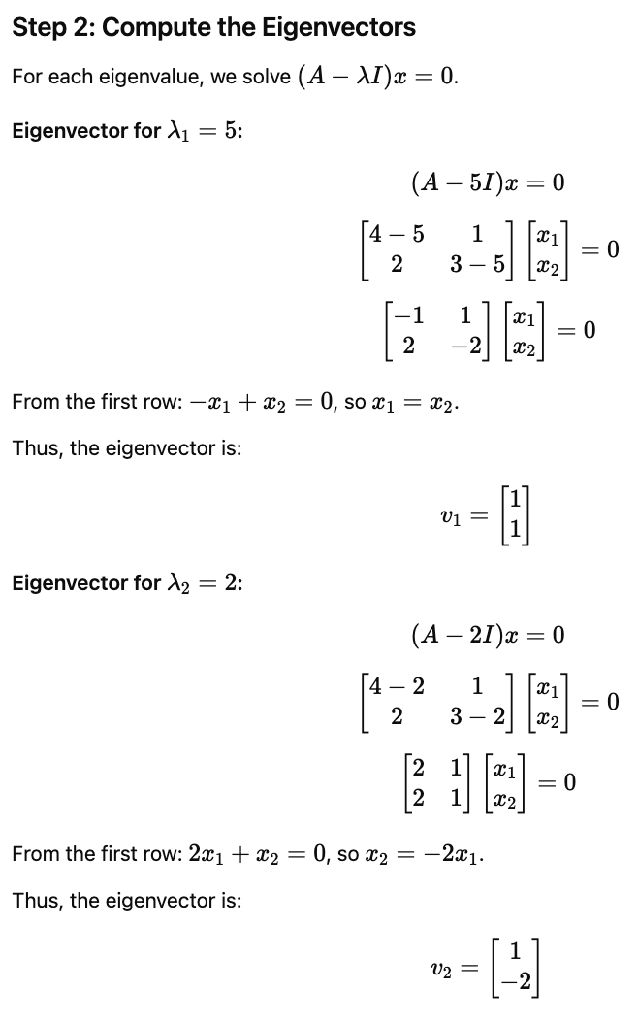
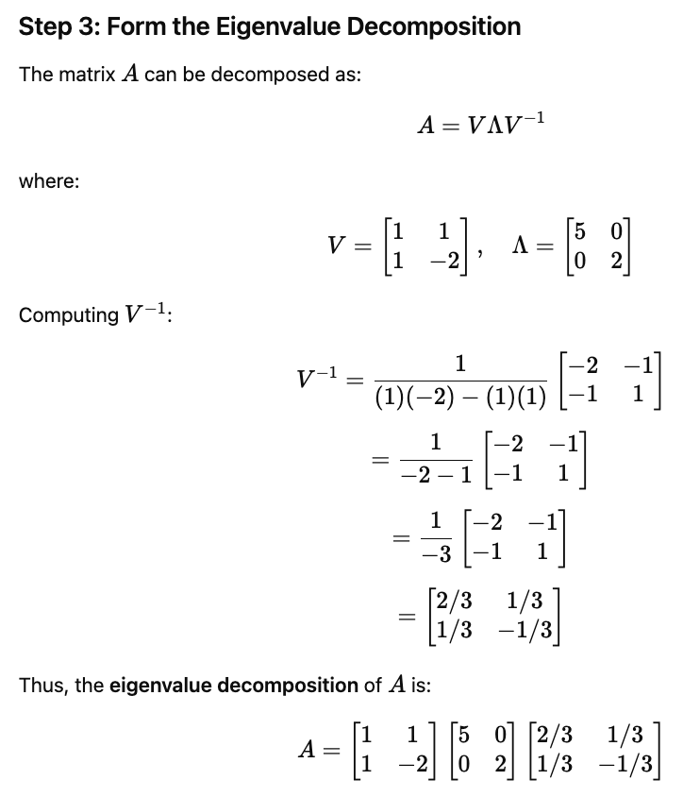
Sample Question
Perform Eigen Value Decomposition for

Slide 9
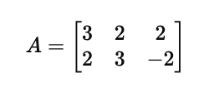
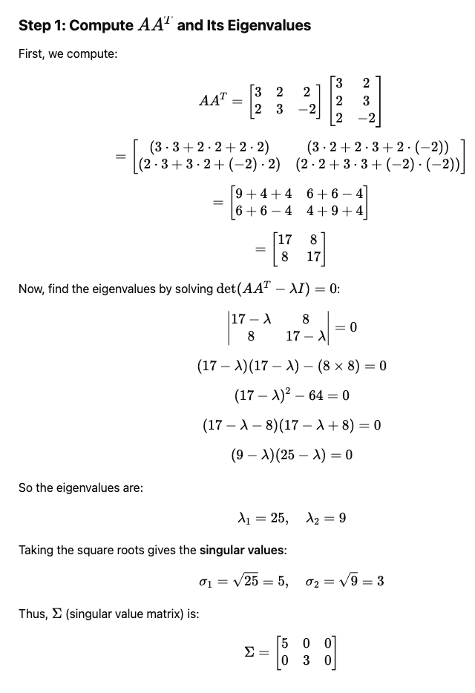
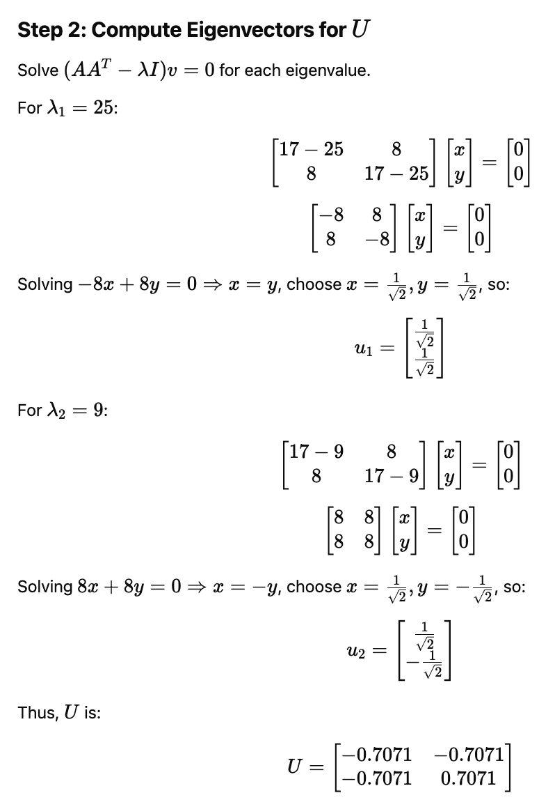
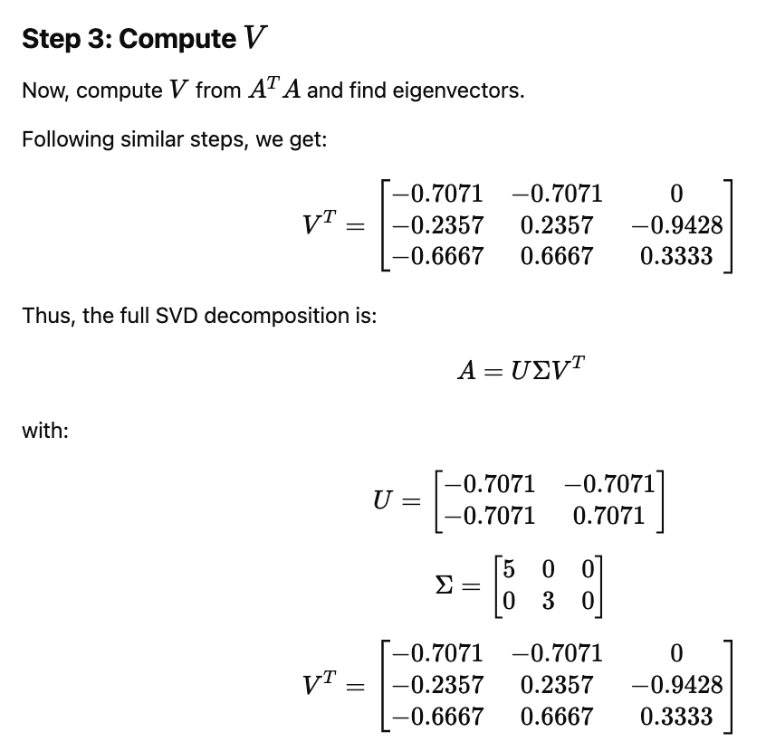
Sample Question
Perform Singular Value Decomposition for

Slide 10
Topics on which Week 5 Assignment Questions are based
Eigen Vectors and Eigen Values
Linear Algebra (linearly independent basis)
Principal Component Analysis
Eigen Value Decomposition
Singular Value Decomposition

Slide 11
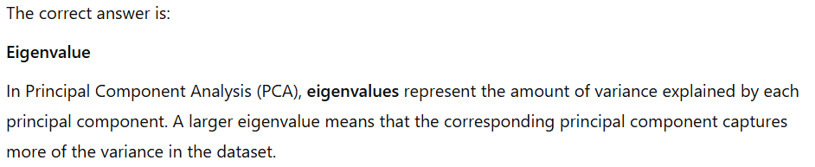
QUESTION 1
Which of the following is a measure of the amount of variance explained by a principal component in PCA?
Covariance
Correlation
Mean absolute deviation
Eigenvalue
SOLUTION 1
CORRECT ANSWER 1
d)

Slide 12
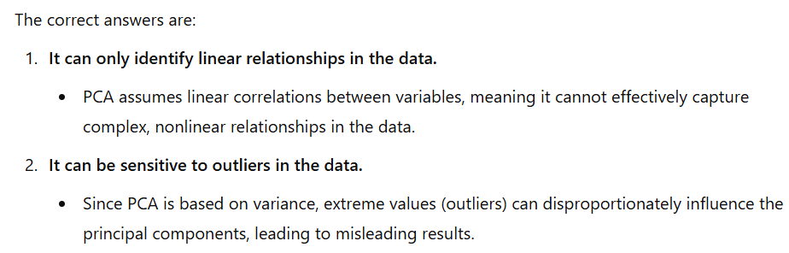
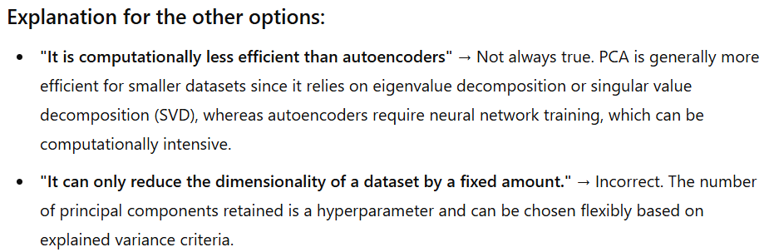
QUESTION 2
What is/are the limitations of PCA?
It is computationally less efficient than autoencoders
It can only reduce the dimensionality of a dataset by a fixed amount.
It can only identify linear relationships in the data.
It can be sensitive to outliers in the data.
SOLUTION 2
CORRECT ANSWER 2
c), d)

Slide 13
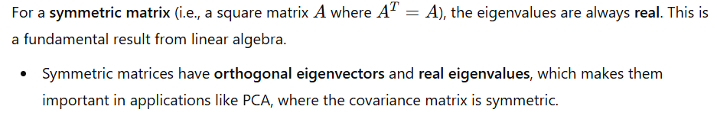
QUESTION 3
Which of the following is a property of eigenvalues of a symmetric matrix?
Eigenvalues are always positive
Eigenvalues are always negative
Eigenvalues are always real
Eigenvalues can be complex numbers with imaginary parts non-zero
SOLUTION 3
CORRECT ANSWER 3
c)

Slide 14
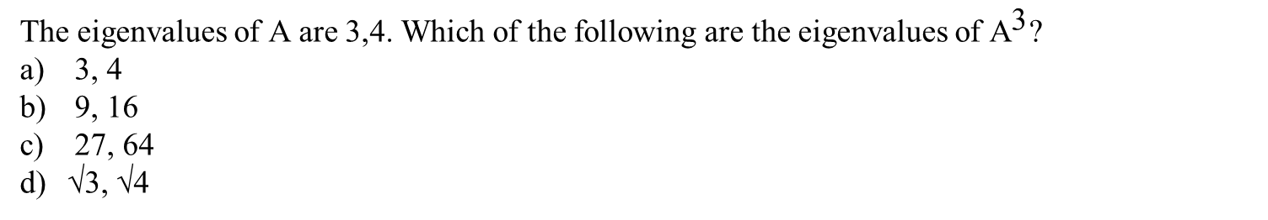
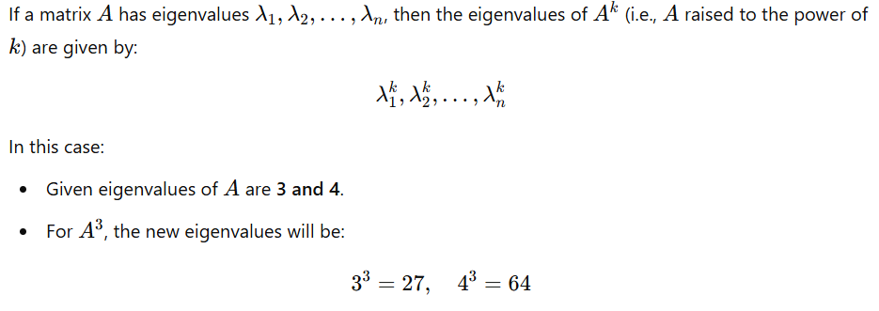
QUESTION 4
SOLUTION 4
CORRECT ANSWER 4
c)

Slide 15
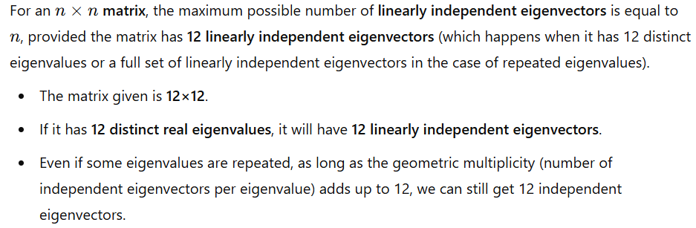
QUESTION 5
If we have a 12×12 matrix having entries from R, what is the maximum number of linearly independent eigenvectors corresponding to real eigenvalues are possible for this matrix?
10
24
12
6
SOLUTION 5
CORRECT ANSWER 5
c)

Slide 16
Questions 6-9 are based on common data.

Slide 17
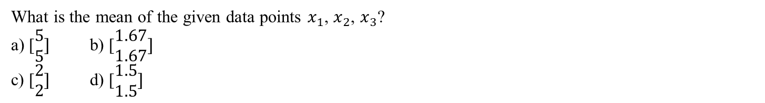
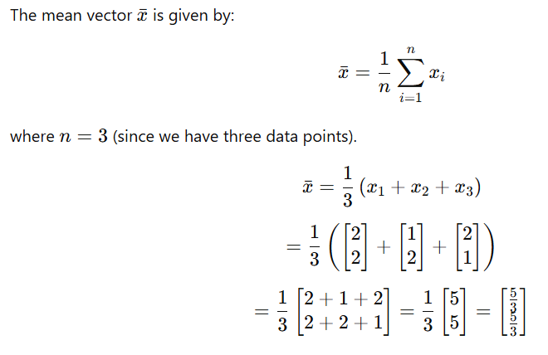
QUESTION 6
SOLUTION 6
CORRECT ANSWER 6
b)

Slide 18
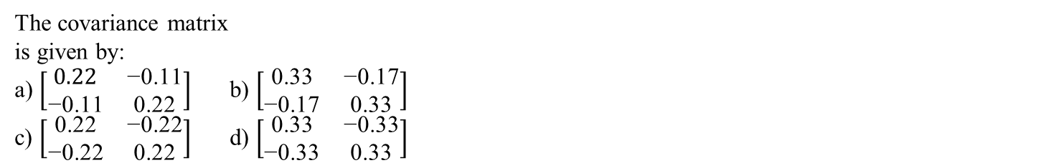
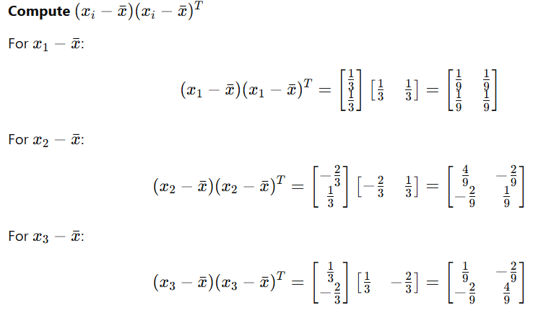
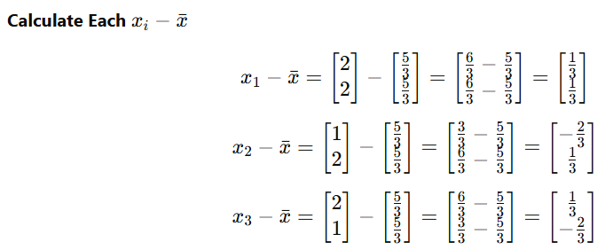
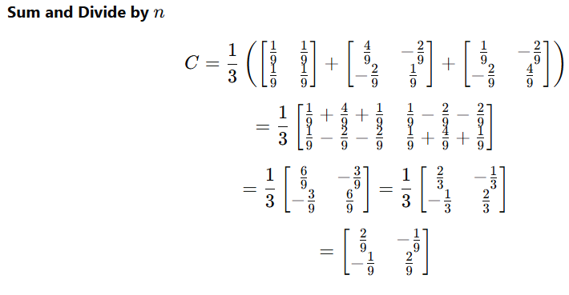
QUESTION 7
SOLUTION 7
CORRECT ANSWER 7
a)

Slide 19
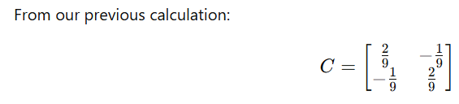

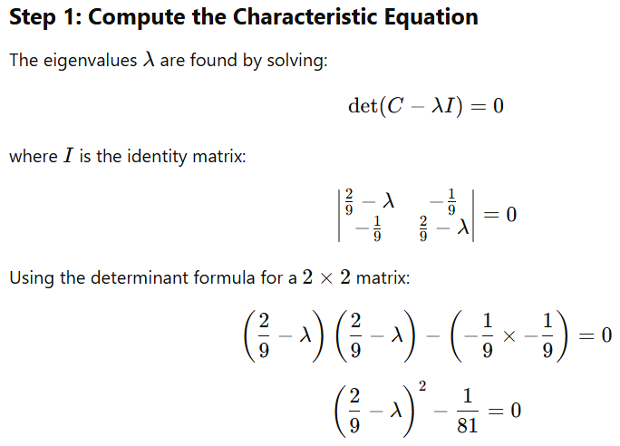

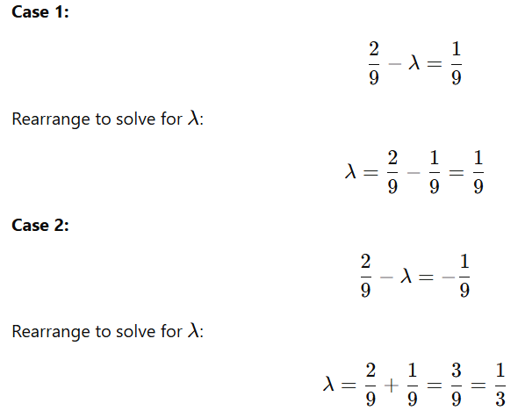
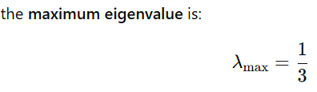
QUESTION 8
The maximum eigenvalue of the covariance matrix C is:
0.33
0.67
1
0.5
SOLUTION 8
CORRECT ANSWER 8
a)

Slide 20
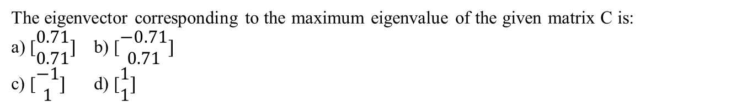
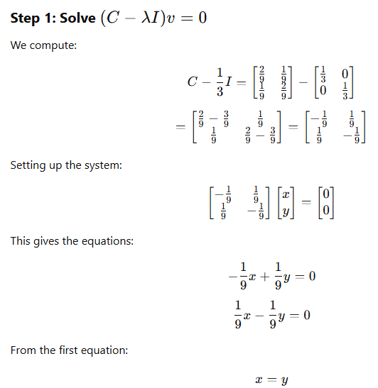
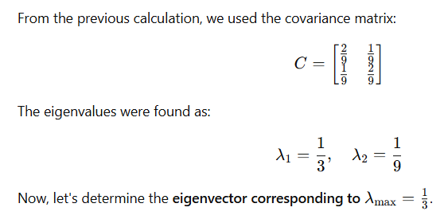

QUESTION 9
SOLUTION 9
CORRECT ANSWER 9
a), d)

Slide 21


QUESTION 10
What is the determinant of a 2×2 matrix that has eigenvalues of 4 and 5?
SOLUTION 10
CORRECT ANSWER 10
20

